Slide 1
Parks and Recreation
Group-Forecasters: Eswar Hemant Majeti- G233R756
CS 896: Data Science Capstone Project
Summer 2023 (CRN 32292)
Instructor:
Dr. Fujian Yan
Fujian.yan@wichita.edu

Slide 2
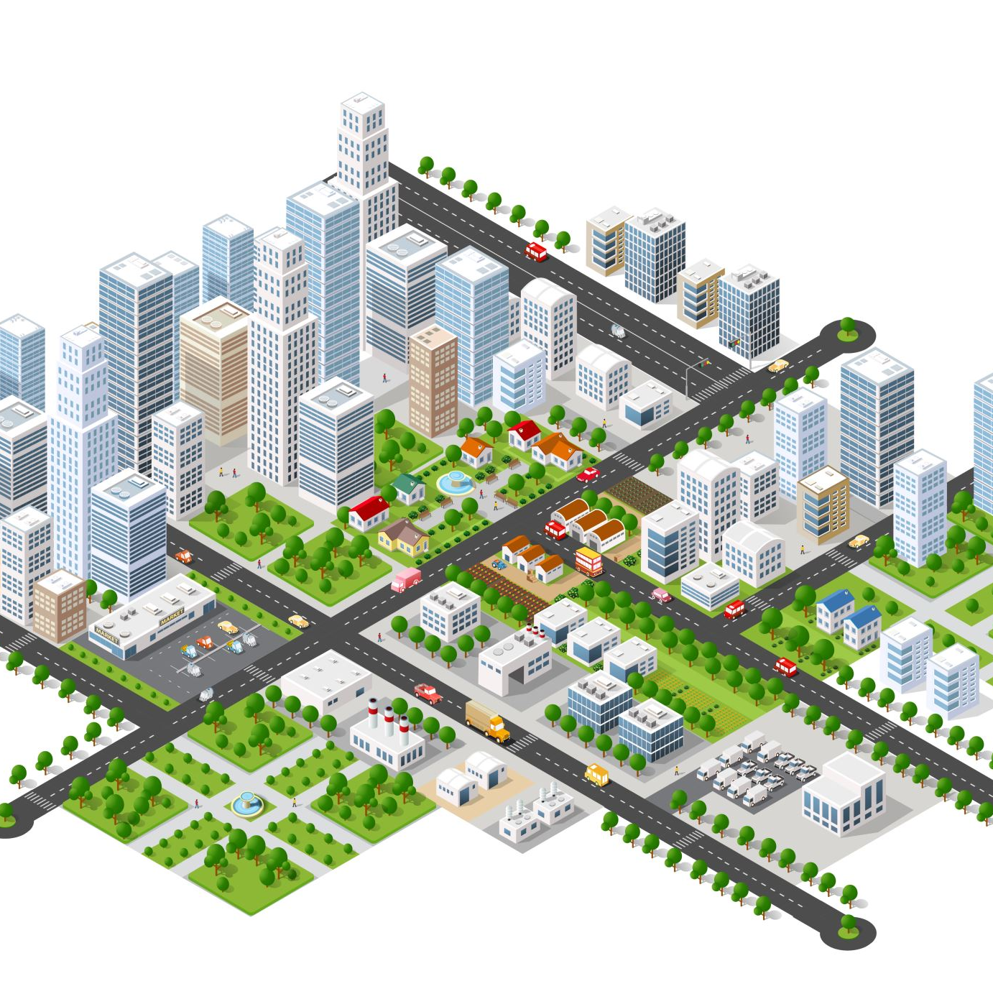

Problem Statement
Facilities allow multiple bookings per day. If Parks and Rec adjusted to allow only one booking per day, would demand be able to spread across the multiple facilities?
2

Slide 3



To ensure a fair distribution and optimal utilization of facilities, it may be necessary to implement a booking system that allows customers to easily view the availability of all facilities and make their reservations accordingly.
This way, customers can choose from the available facilities based on their preferences and convenience.
Why the problem is important?

Slide 4

Machine Learning Models
Multiple Regression
Decision Tree
Gradient Boosting
Random Forest

Slide 5
Why the proposed method is suitable for the current case?
Decision trees provide a structured approach to decision-making by splitting the data based on different conditions.
Random Forest: It can be effective for predicting facility bookings by considering multiple features and capturing complex relationships between the features and booking outcomes.
Multiple Regression: It assumes a linear relationship between the input features and the demand. By fitting a line to the data, it estimates the demand based on the values of the input features.
Gradient Boosting: iteratively building an ensemble of weak learners and combining them to make predictions. They can handle a large number of features and capture complex relationships.

Slide 6

Math Models for the Proposed Methods
Multiple Regression:
y = β₀ + β₁x₁ + β₂x₂ + ... + βₙxₙ + ε
Decision Tree: Top-down from a root node and involves partitioning the data into subsets that contain instances with similar values (homogeneous)
Random Forest: The results of decision trees are aggregated at the end of the process
Gradient Boosting: The results of each decision tree along the way to calculate result

Slide 7
Dataset Description
The Data provided consists of Facility calendar form the year 2013 to 2022.
There are 6 Facilities:
Stephen_Mason_Carnegie
Stephen_Mason_CB
Stephen_Mason_ELC
Stephen_Mason_HPC
Stephen_Mason_SPL
Stephen_Mason_UP Depot
The Data set consists of a total of 69 files
PDF: 59 Files consisting of yearly based facility calendar
XLS worksheet-10 Files consisting of yearly data of all locations

Slide 8
Variable | Type | Description
Facility Class | Categorical | There are a total of 17 classes provided Each class has one or more facilities under it.
Facility Location | Categorical | Various building locations of LPRD
Facility Code | Categorical | Assigned code for each Facility in the buildings
Facility | Categorical | The type of Facility booked for various events
Status | Categorical | Status of the reservation(Firm, Hold, Internal, Tentative)
Reservation type | Categorical | Reservation type is a variable used to describe the type of booking it is. (Facility or Activity)
Begin Time | Time | Start time of the event.
End Time | Time | End time of the event.
Begin Date | Date | Start date of the event.
End Date | Date | End date of the event.
Head Count | Numerical | Number of people attending the event.
Variables Used

Slide 9
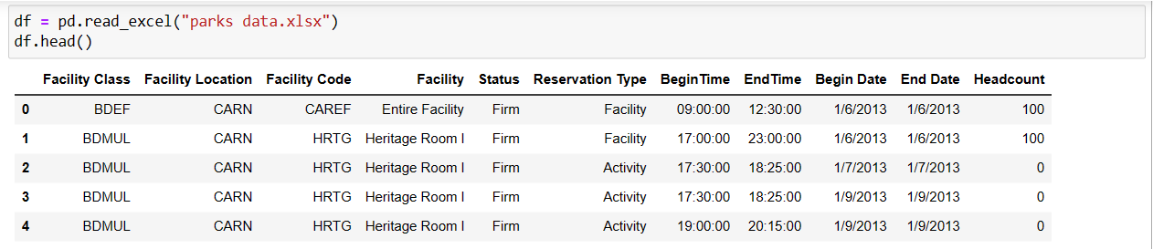
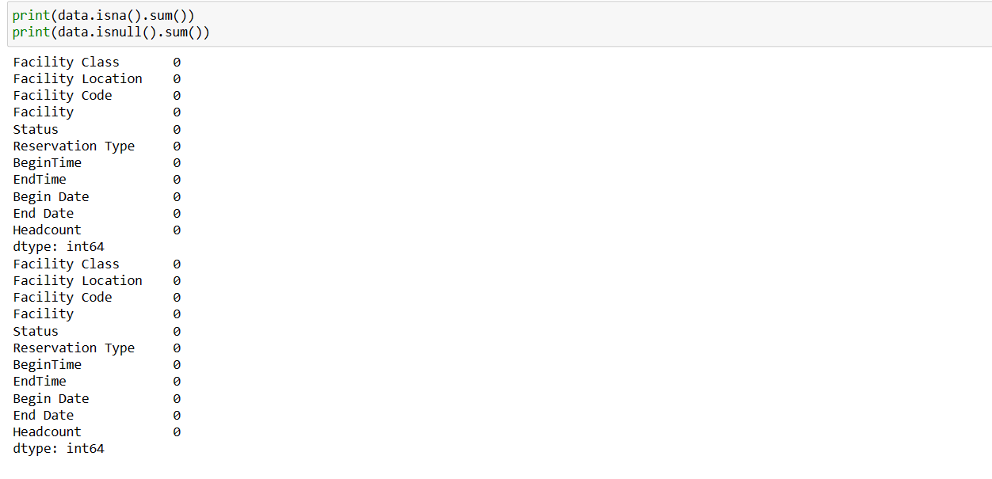
DATA PRE-PROCESSING
Size of Data set provided in Excel on yearly basis: [123649 rows x 11 columns]
2013- [8012 Rows x 11 Columns]
2014- [10632 Rows x 11 Columns]
2015- [13111 Rows x 11 Columns]
2016- [14459 Rows x 11 Columns]
2017- [15897 Rows x 11 Columns]
2018- [15536 Rows x 11 Columns]
2019- [15319 Rows x 11 Columns]
2020- [8380 Rows x 11 Columns]
2021- [9418 Rows x 11 Columns]
2022- [12885 Rows x 11 Columns]
9

Slide 10
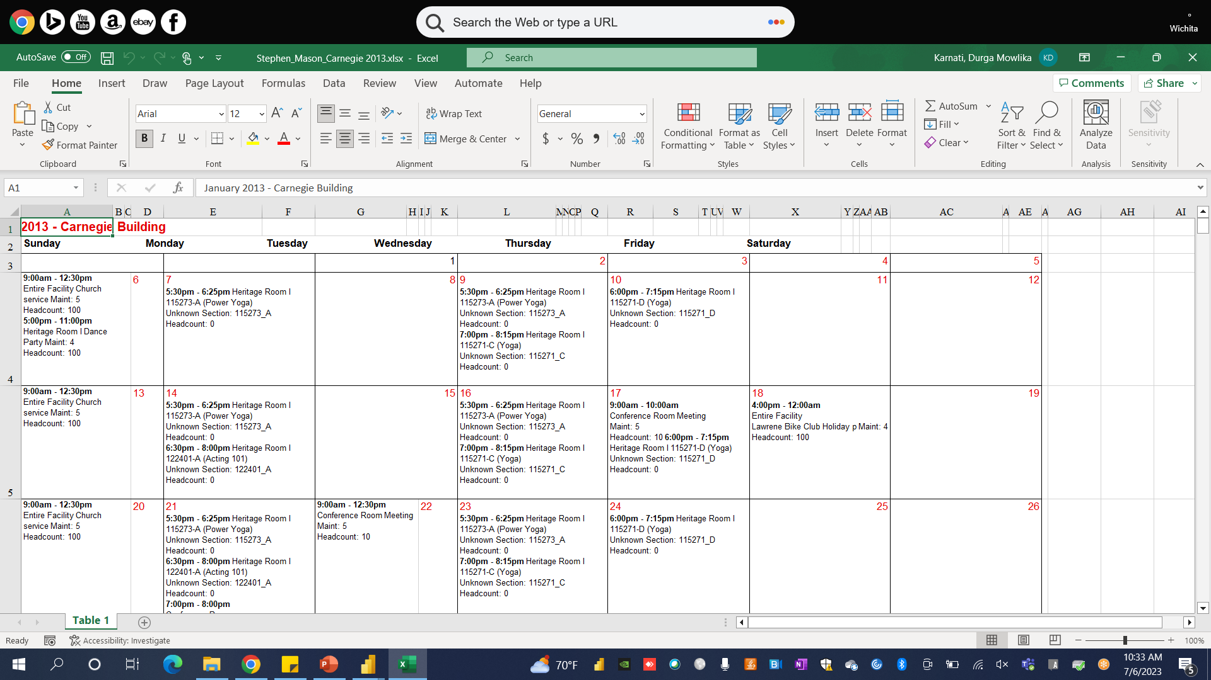
Facility Calendar

Slide 11
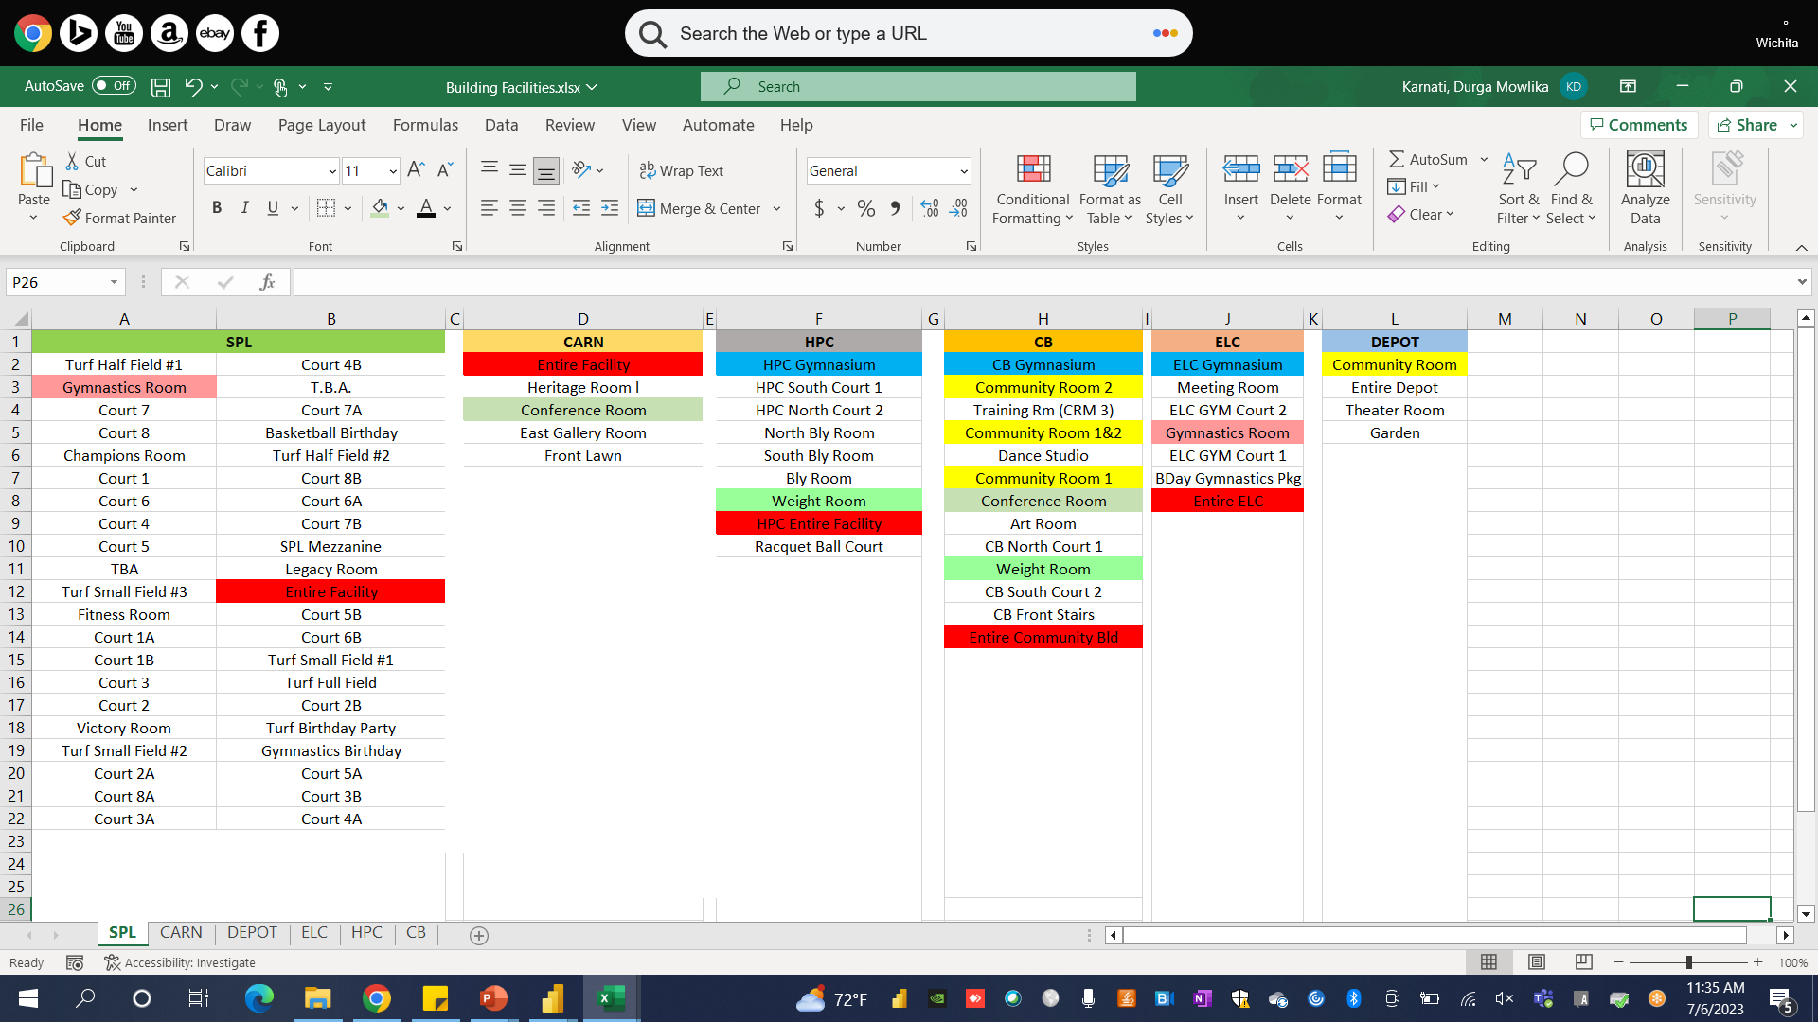
Common Facilities across the facility Locations

Slide 12
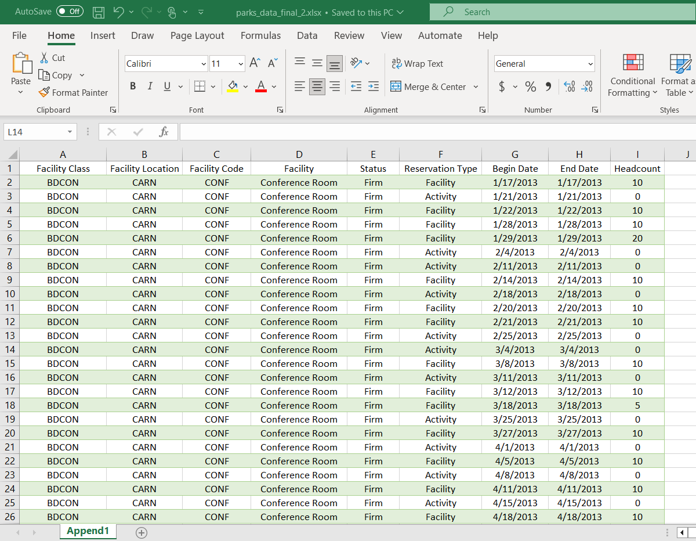
Data Set for Single booking/day for each common facility

Slide 13
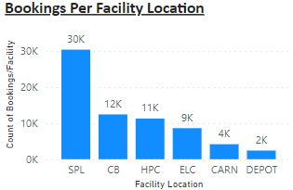
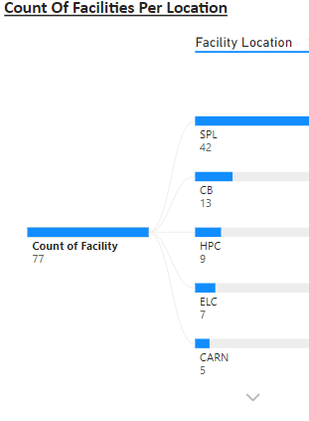
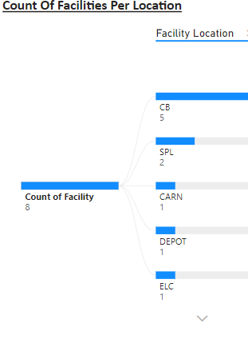
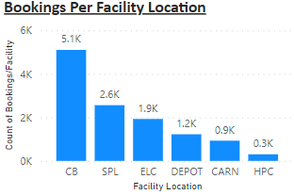
For Multiple Booking Data
For Single Booking Data
For Multiple Booking Data
For Single Booking Data

Slide 14
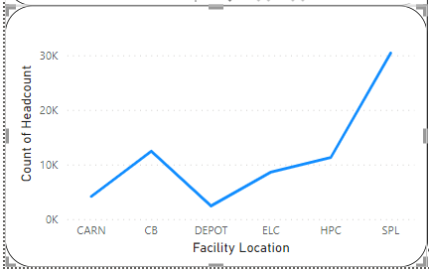
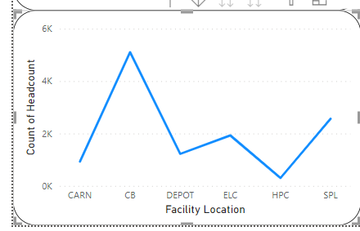
Total Number of bookings for each facility location
Line Graph for Multiple Booking Data
Line Graph for Single Booking Data

Slide 15
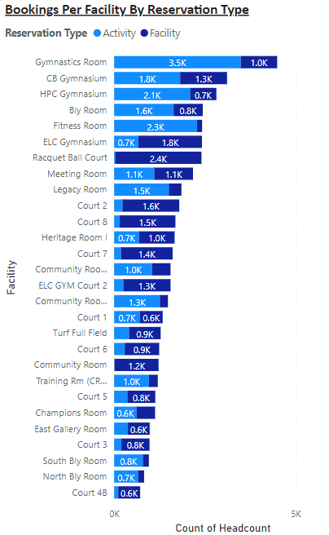
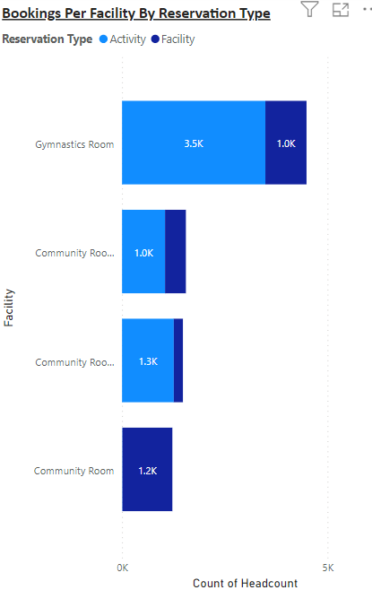
With Multiple Bookings Data
With Single Booking Data
After Transforming the data

Slide 16
Process for testing the models
Parks Data Set
['year'] >= '2013' & ['year'] <= ‘2020'
['year'] >= 2021
Training Data Set
Testing Data Set
Models

Slide 17
Results Table:
Model vs metrics | Regression | Decision Tree | Gradient Boosting | Random Forest
MSE | 1.041 | 1.031 | 1.056 | 1.031
RMSE | 1.02 | 1.015 | 1.027 | 1.016
MAE | 0.678 | 0.675 | 0.709 | 0.676
R-Squared | 0.416 | 0.411 | 0.407 | 0.410

Slide 18
Challenges encountered with the dataset
The Provided Data is distributed across 69 files out of which 59 files are in PDF format and 10 are XLS files
The data Provided in the PDF are in calendar schedule format with different timings on each day
Extracting the data from these PDFs makes Data Pre-processing difficult and time taking process.
The extracted data need to be converted into Numerical format.

Slide 19

Conclusion
The facilities available at each location vary significantly, with a notable disparity in the number of amenities provided.
This limited range of options makes it difficult to meet the diverse demands and preferences of individuals seeking these facilities.
The variables provided do not offer sufficient information to assess the impact on demand distribution.
To reach a definitive conclusion, additional analysis and careful consideration of relevant features are necessary like demand per facility, seating availability etc.

Slide 20
Tasks Distribution
Data extraction:- Eswar, Sudheer
Data Pre-processing:- Mowlika, Eswar, Sudheer
Python Coding:- Eswar, Mowlika, Sudheer
Visualization:- Eswar, Mowlika
Documentation:- Sudheer, Mowlika
Optional Comments: All the team members will be contributing to an extent in all the tasks, but their major part of contribution is mentioned as above.

Slide 21

Any Questions?

Slide 22

THANK YOU..!!

